Slide 1
Introducing the Toolbox Project
Michael O’Rourke & Chad Gonnerman
Michigan State University
The Toolbox Project
http://www.cals.uidaho.edu/toolbox/

Slide 2
Outline
What Have We Done?
What Do We Know?
Where Are We Going?

Slide 3
What Have We Done?
Executive Summary
Communication is a key challenge to building interdisciplinary research capacity
The Toolbox approach aims to enhance communication
We run workshops that involve philosophically structured dialogue among collaborators
Workshop goals are greater self- and mutual understanding, and through that, enhanced communication
We work with partners to develop structured dialogue that addresses their specific concerns

Slide 4
What Have We Done?
Better Science through Philosophy
Leading Idea:
Enhanced understanding → Enhanced communication
One can enhance understanding by using philosophy to frame reflection on research assumptions
Concepts: Philosophy systematically reveals these assumptions
Methods: Philosophy provides abstract common ground for dialogue about these assumptions
The Goal: Enhance communication and increase collaborative capacity by reducing the amount “lost in translation” across knowledge cultures

Slide 5
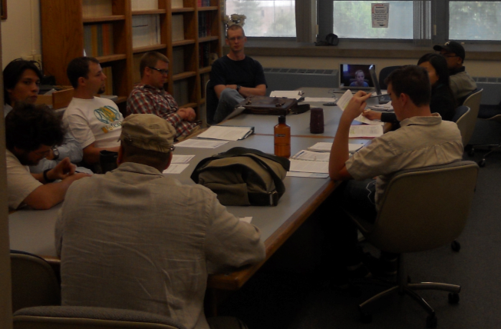
What Have We Done?
An Instrument and a Workshop
The Toolbox Instrument
A set of modules containing conceptual prompts that reveal fundamental research and practice assumptions
They address epistemic, metaphysical, and evaluative dimensions
E.g.: “Scientific research must be hypothesis driven”
The Toolbox Workshop
Begins and ends with participants scoring the Toolbox
2 hour dialogue about research assumptions structured by the Toolbox
Various follow-up data collected
Notes:
The Toolbox instrument categories are each subdivided into three subcategories and contain a “Core question” and “probing statements”.
Other examples of statements: “Models invariably produce a distorted view of objective reality”, “The principal value of research stems from the potential application of the knowledge gained”, “Validation of evidence requires replication”, “Value-neutral scientific research is possible”, “The world under investigation is fully explicable as the assembly of its constituent parts.”

Slide 6
What Have We Done?
A History
Motivated by graduate students in a team-based Integrative Graduate Education and Research Traineeship (IGERT) project at U. Idaho (UI)
2005 seminar, “Philosophical Issues in Interdisciplinary Research”, co-taught by Eigenbrode and O’Rourke
Led to Eigenbrode et al. (2007) Employing philosophical dialogue in collaborative science. BioScience 57: 55­64.
Development of dialogue-based workshops funded by UI and NSF (SES-0823058, 2008; SBE-1338614, 2013)
We have conducted 127 workshops around the world involving over 1200 participants

Slide 7
What Do We Know?
Assessing Toolbox Interventions
Goal: use various data – e.g., Likert responses, workshop transcripts, post-workshop surveys – to determine whether Toolbox enhance mutual and self-understanding of philosophical assumptions about scientific practice
Two examples:
Analysis of post-workshop surveys (e.g., Schnapp et al., 2012)
Analysis of transcript and Likert data (e.g., Outcomes)

Slide 8
What Do We Know?
Evidence of Impact – Post-Workshop Surveys
Table 1. STEM workshop participant assessments (n=139) of the impact of the Toolbox workshop (from Schnapp et al. (2012) How to talk to strangers: Facilitating knowledge sharing within translational health teams with the Toolbox dialogue method. Translational Behavioral Medicine, 2(4): 469-479.)

Slide 9
What Do We Know?
Taking the “Philosophical Pulse” of Science
Goal: sketch an account of the attitudes that populate scientists’ research worldviews and how they vary (or don’t vary) across dimensions like gender and disciplinary background
Two examples:
Analysis of prompts having to do with hypotheses in science (e.g., Donovan et al.)
Analysis of various prompts having to do with values in science (e.g., Steel et al.)

Slide 10
What Do We Know?
Some Results – Values
Participants in the STEM sample tended to
(1) disagree with the claim that objectivity implies an absence of values, with 68.2% disagreeing (χ2 (1, N = 289) = 38.15, p < .001)
(2) disagree with the claim that incorporating one’s personal perspective in framing a research question is never valid, with 74.4% disagreeing (χ2 (1, N = 289) = 68.79, p < .001)

Slide 11
What Do We Know?
Reporting for Our Hosts
Goal: deliver reports with observations helpful to workshop participants
Two types:
Executive reports – delivered within a week to the leadership of the participating project
Participant reports – delivered after collection of post-workshop questionnaires, typically months later

Slide 12
What Do We Know?
Demographic differences
Procedure: run independent samples t-tests on the pre-workshop Likert (1-5) scores and demographic variables
Examples: REACCH workshops
(1) Men were more inclined to agree than woman that allowing values to influence scientific research is advocacy (men: n=27, M=3.04, SD=1.06; women: n=17, M=2.29, SD=.77): t(42)=2.69, p<.01, d=.83)
(2) Agriculturalists were more inclined to disagree than non-agriculturalists that science is amoral (agriculturalists: n=23, M=1.78, SD=1.09; non-agriculturalists: n=22, M=2.55, SD=1.10): t(43)=2.34, p<.03, d=.70)

Slide 13
Where Are We Going?
Partnerships with Larger Initiatives
Goals: Position the Toolbox Project to (a) develop and test its approach in a specific context over time, and (b) aid partners to develop their collaborative capacity
Approach:
Identify large projects that value interdisciplinary research and offer our services in a form that makes sense for the partner
This has entailed developing new Toolbox instruments and workshop protocols
Partners: BEACON (NSF), ITHS (NIH), NWCSC (Interior), REACCH (USDA), GLEON (NSF), SCRiM (NSF), AgBioResearch (USDA), various IGERTs (NSF)

Slide 14
Where Are We Going?
One Size Doesn’t Fit All
We began thinking that we could develop one approach to rule them all
We have realized that this is not going to work
Since late 2010 we have recognized the need to adjust the approach to suit partner needs
Elements: instrument, workshop model, follow-up
Notes:
REACCH, SCRiM, Upper Midwest/Great Lakes Landscape Conservation Cooperative

Slide 15
Where Are We Going?
A Few of the Adjustments
Instrument: Bottom-up development with clients using this protocol:
Workshop: Intro + Full workshops, use of clickers
Follow-up: Executive report on-site, use of case studies to fix gains in specific context
Data gathering from relevant literature
Discussion with partner leads about priorities and emphasis
Development of module themes and statement language
Review and revision of themes and statement language
Analysis of gathered data
Pilot test of new Toolbox language
Data gathering from partner community
Notes:
REACCH, SCRiM, Upper Midwest/Great Lakes Landscape Conservation Cooperative

Slide 16
Where Are We Going?
Open Questions
Are there other ways of evaluating the data we have to yield insight into the effects Toolbox dialogue have on understanding?
How might we evaluate the “leading idea” of the project, viz., that enhanced mutual understanding promotes enhanced communication about science?
Are there any other “philosophical pulse” projects that we might get out of the data?
Is there a testable relation to decision making?
What of transdiscipinary deployments?

Slide 17
Questions?
?

