Slide 1


as a case study in knowledge integration
Daan Schuurbiers
De Proeffabriek / Responsible Innovation Collective
CoI 2014 - 9-12 June - Kitchener, Ontario CA

Slide 2






1995 - 2000
2002 - 2005
2005 - 2008
2008 - 2009
2010
2011
2013
"Translating insights from social research into technological practices"
Responsible Innovation Collective

Slide 4

Give citizens and CSOs a voice in nanotechnology development (!)
Determining safe use of nanomaterials (!)
Encourage responsible research and innovation
Activities along the innovation value chain

Slide 5
Knowledge integration at two levels
Content: integrating social considerations in research and policy decisions

Slide 6
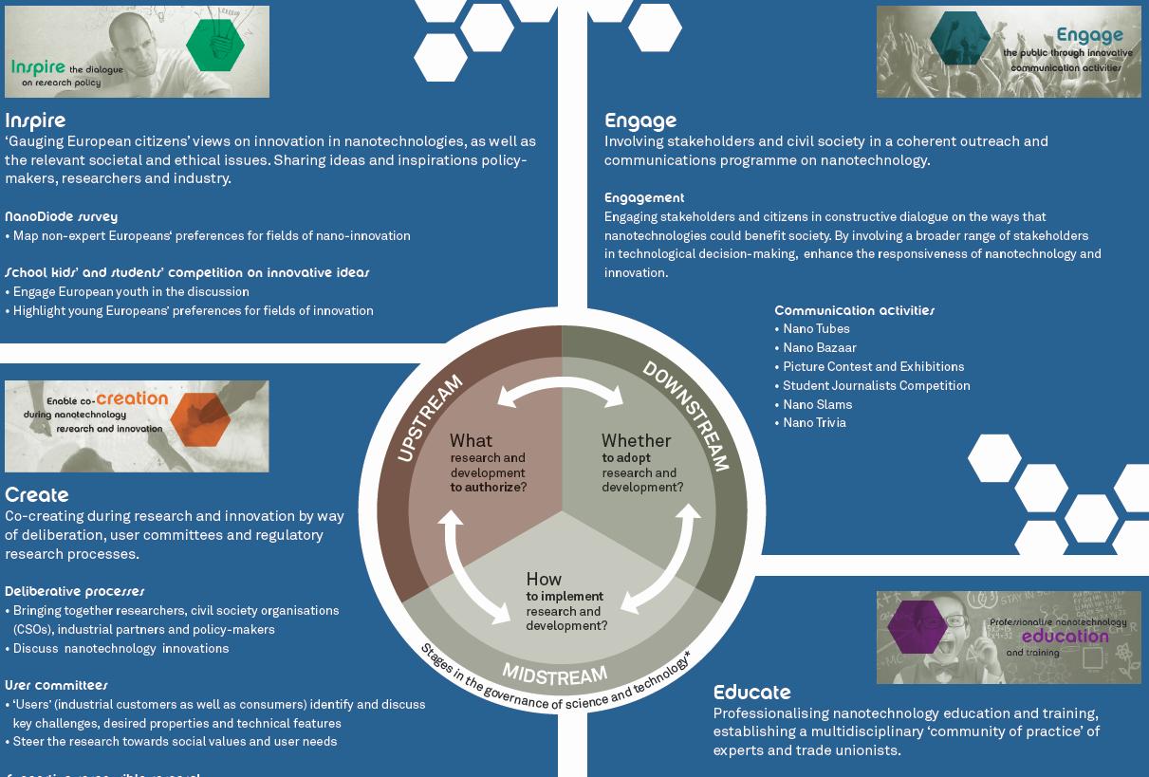

Slide 7
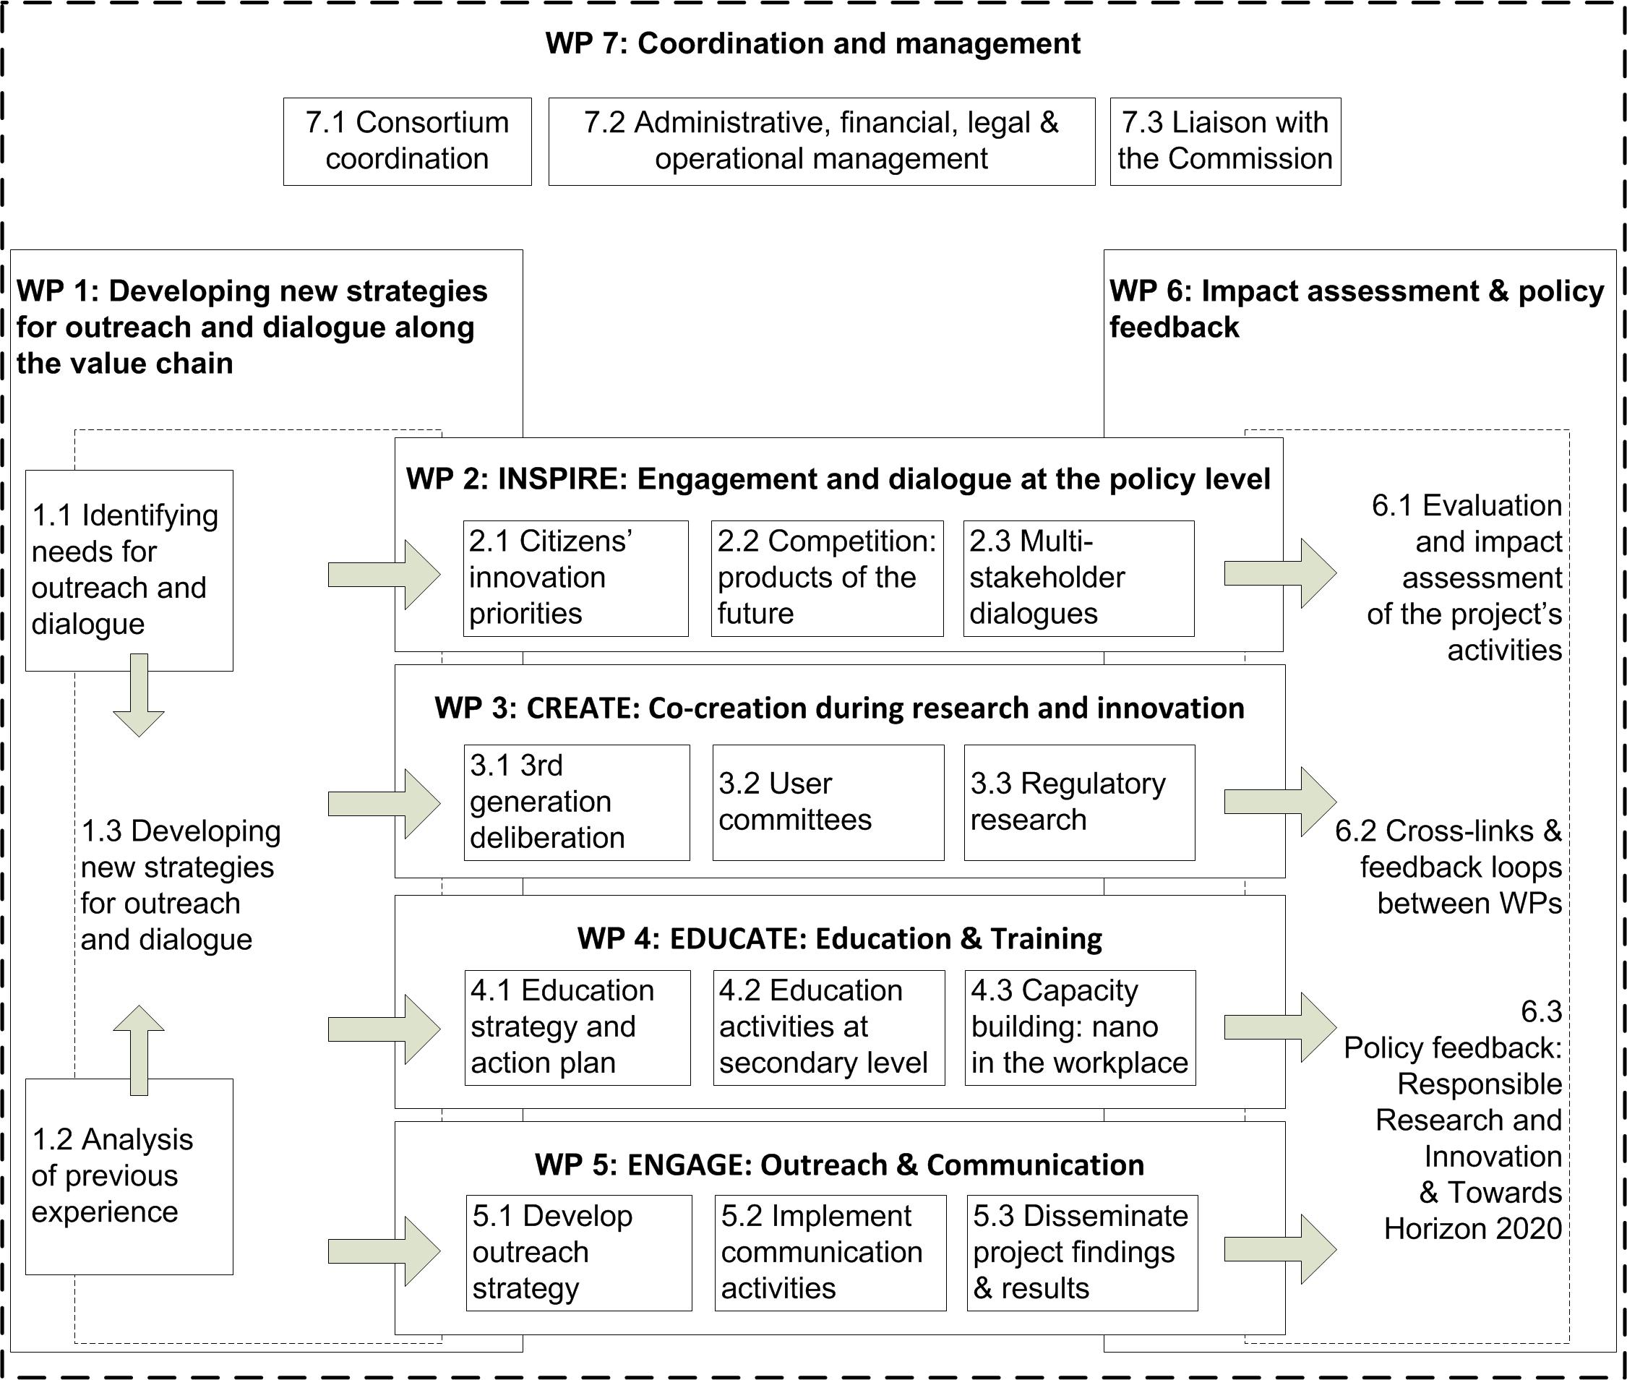

Slide 8

Knowledge integration at two levels
Content: Integrating social considerations in technological decisions
Process: enabling dialogue within the consortium:
  introducing the poldermodel in Europe?

Slide 10







The genetics clinic of the future

Slide 11
